Slide 1
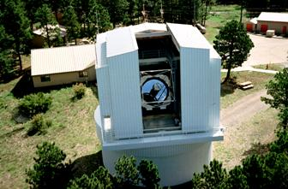
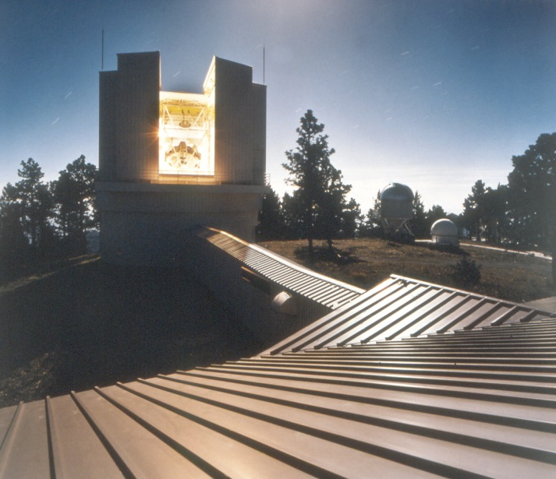
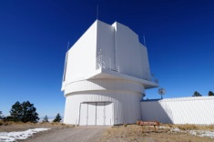

Slide 2
An Ultrafast Review:
Decades of the 3.5^{m} Telescope
1960s: several of the eventual ARC members realize that the Palomar 200” and Lick 120” should not be allowed to dominate faint object observational astronomy
1970s: same institutions realize KPNO and CTIO cannot grant enough 4^{m} observing time for a top quality department

Slide 3
Decades of the 3.5^{m} Telescope (cont’d)
1980s: multiple friends of Roger Angel (Arizona) realize a spun-cast, light weight, fast 3.5^{m} mirror might be available for a physically small but optically powerful telescope
1980s: 7-8 departments dance around each other; the music stops with UW, Chicago, NMSU, Princeton, WSU forming ARC

Slide 4
An Extraordinary Labor and Delivery
1984 January 26: five universities sign the Astrophysical Research Consortium agreement
1994 May 10: ARC 3.5m is dedicated during a total solar eclipse

Slide 5
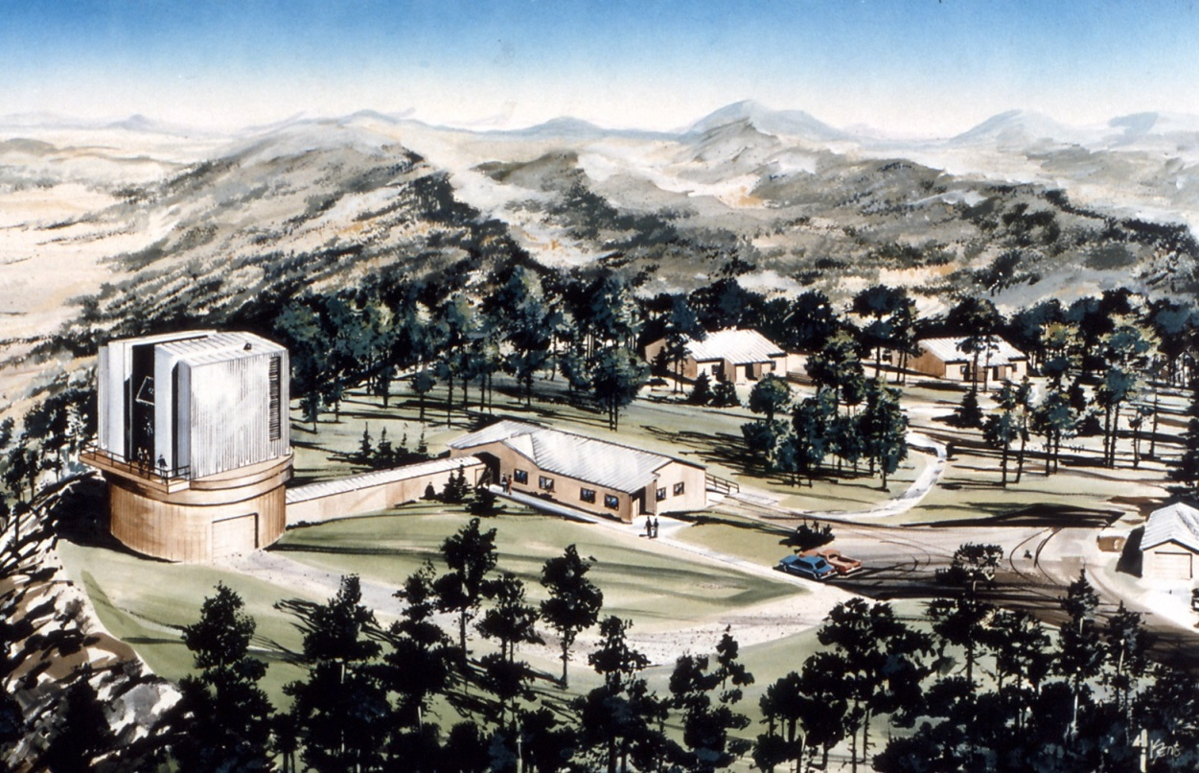
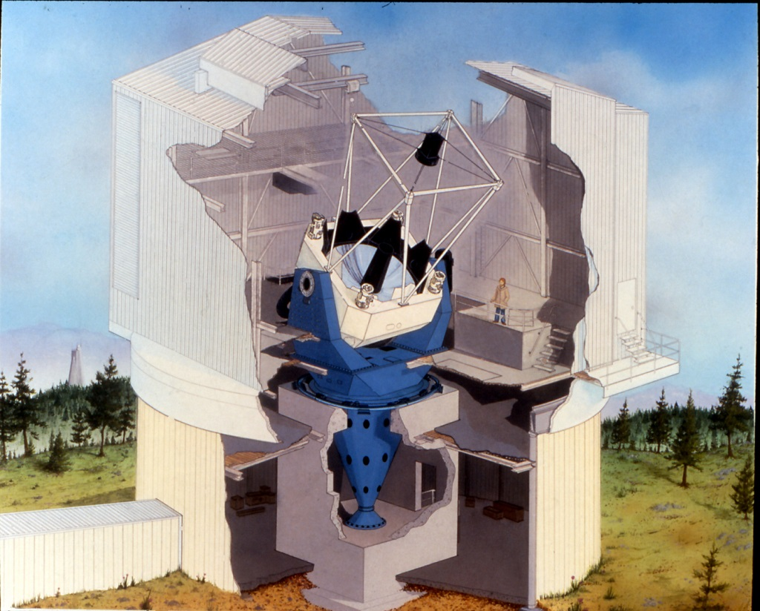
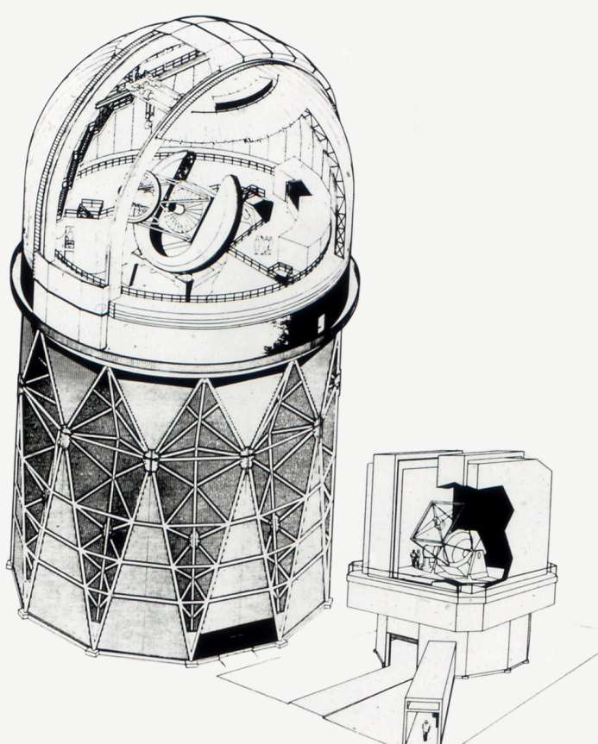
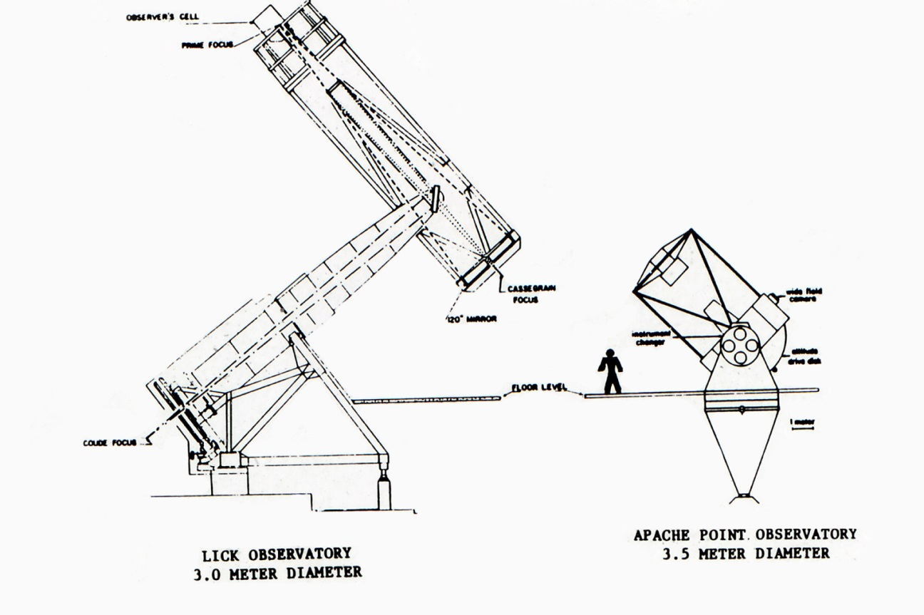

Slide 6
From the Oxford English Dictionary:
“Vaporware”
Pronunciation: /ˈveɪpəwɛə(r)/
1984: PC 7 Feb. 49/1. Esther Dyson..has appropriately coined the term ‘vapor ware’ to refer to all the integrated windowing software that doesn't exist—apparently.

Slide 7

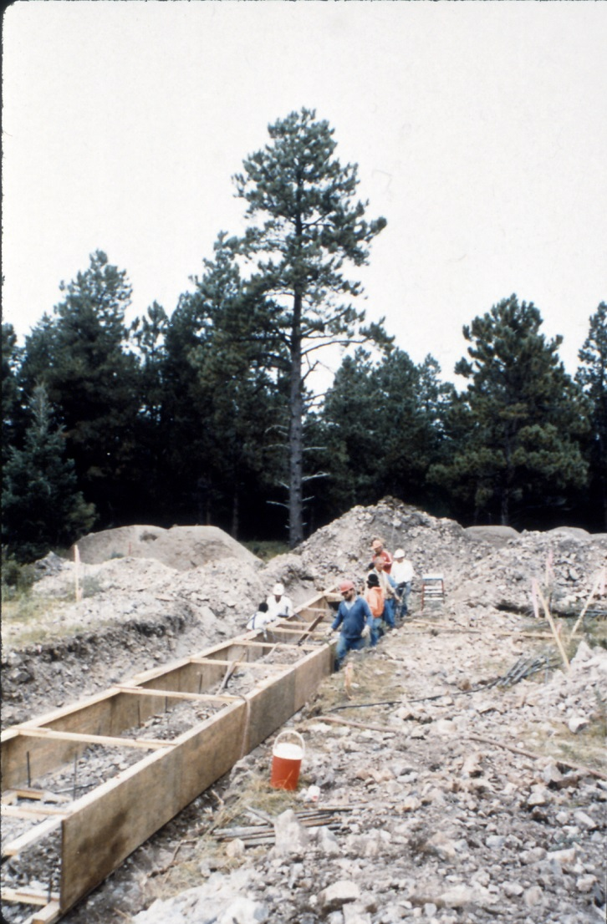
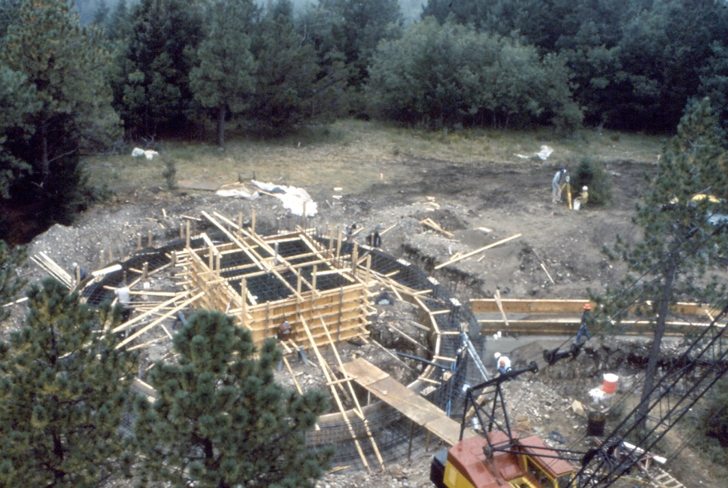

Slide 8
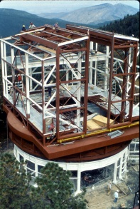

Slide 9
Lessons Learned
The Zeno’s Paradox of financing telescopes:
If you wait to identify the full cost of a telescope project before proceeding, during that wait the cost will increase beyond your reach.

Slide 10
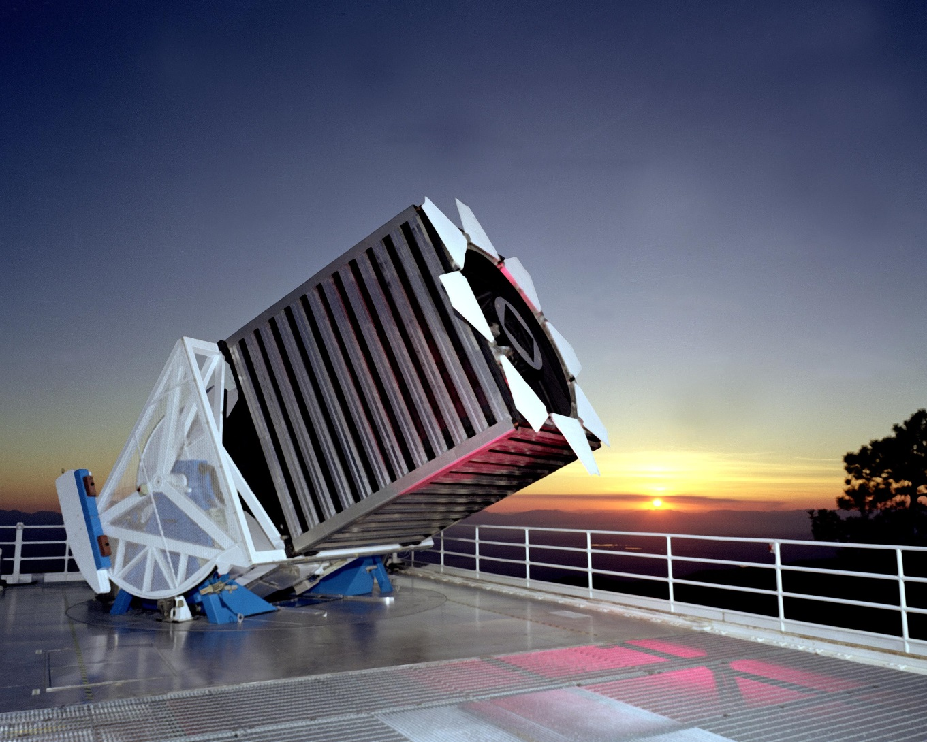

Slide 11
Lessons Learned
The Zeno’s Paradox of financing telescopes:
If you wait to raise the full cost of a telescope project before proceeding, during that wait the cost will increase beyond your reach.
The Stockholm Syndrome of financing telescopes:
The most indispensable participant in a telescope project may be a non-astronomer.

Slide 12
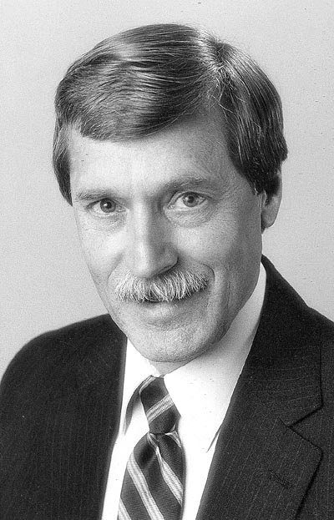

Slide 13
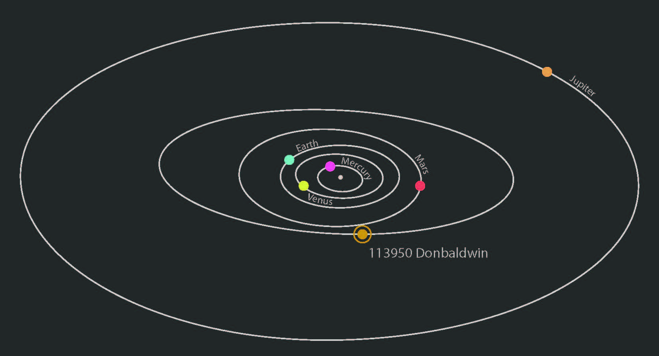
Minor Planet 2002 TC315 (“113950 Donbaldwin”)
Period 5.2 years, orbital semi-major axis 3.0 AU
Discovered 2002 October 4 by the Sloan Digital Sky Survey at the Apache Point Observatory
Official citation of the International Astronomical Union: “Donald R. Baldwin (1938-2003), a co-founder and treasurer of the Astrophysical Research Consortium, was instrumental in assuring the success of the Sloan Digital Sky Survey.”

